Slide 1
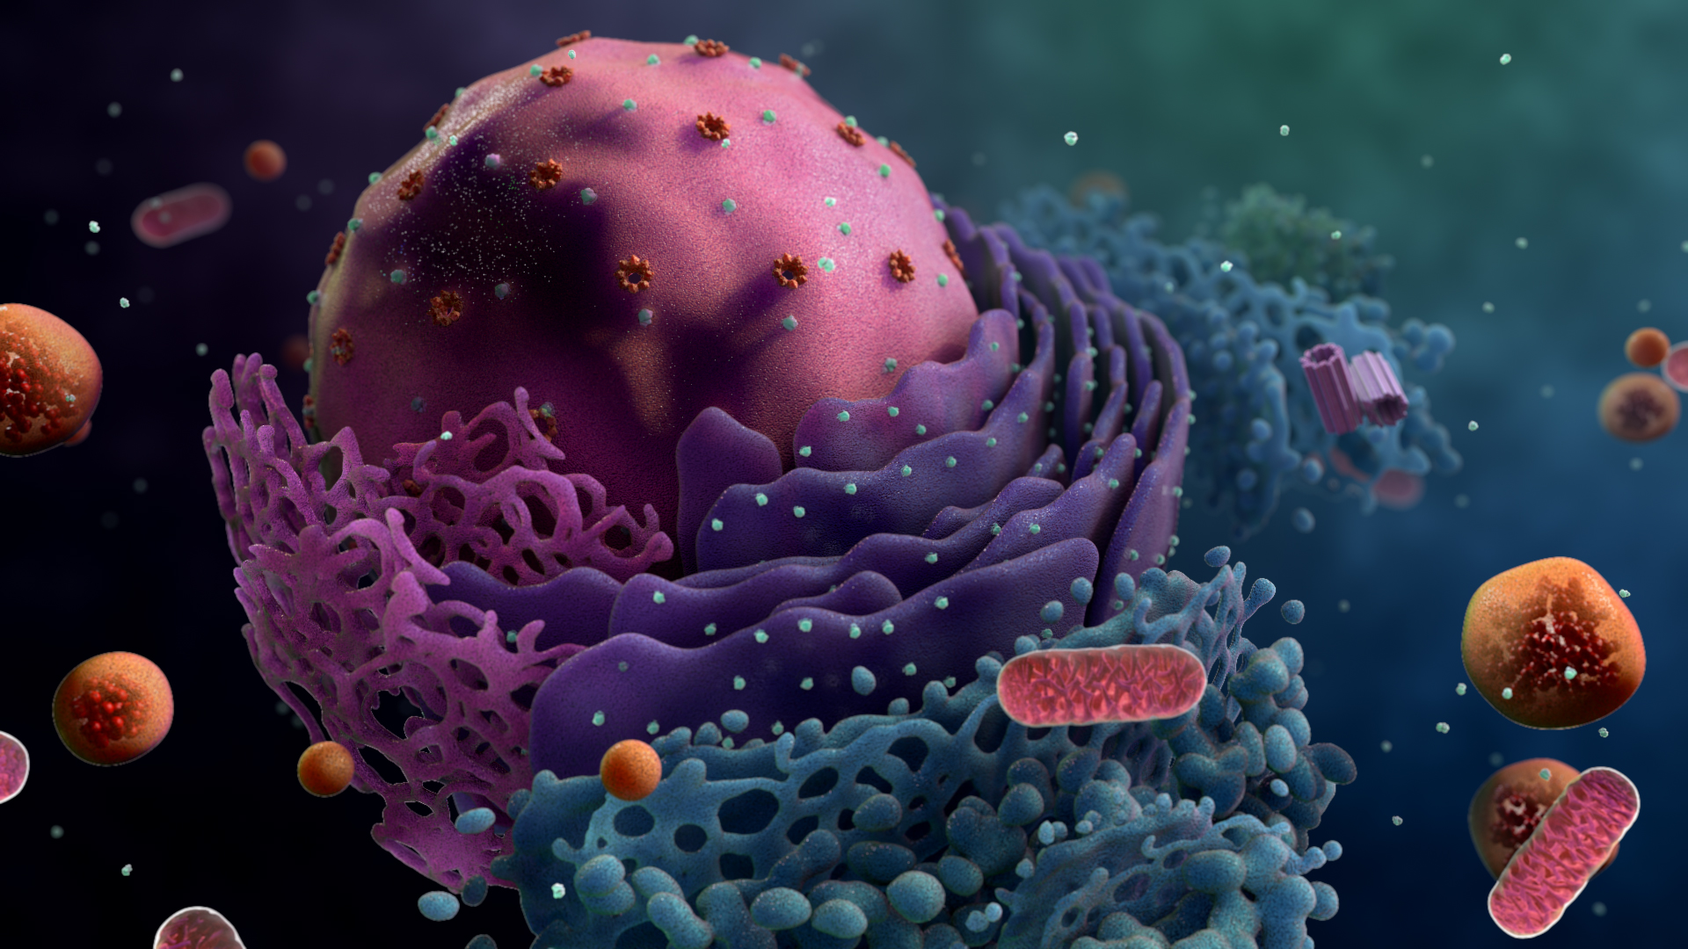
HI-C RESOLUTION ENHANCEMENT
WITH GENOME SEQUENCE DATA
Skoltech DL 2021

Slide 2
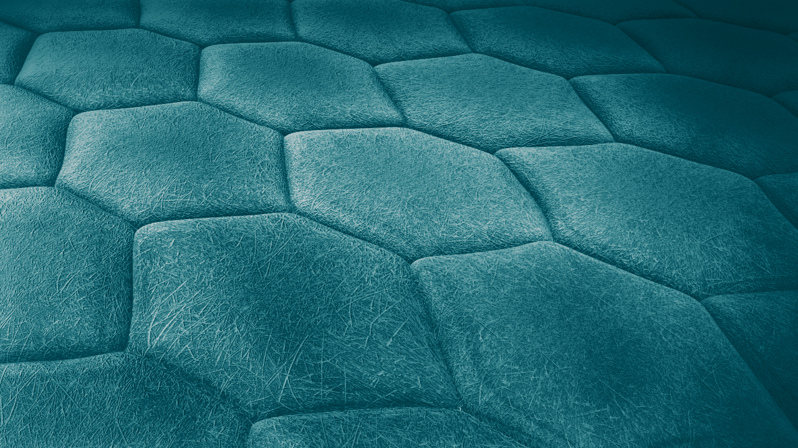
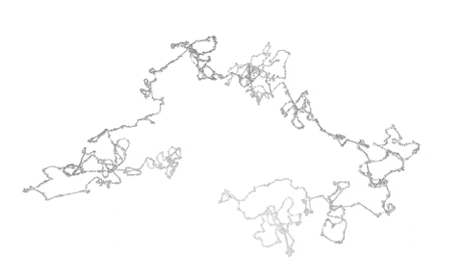
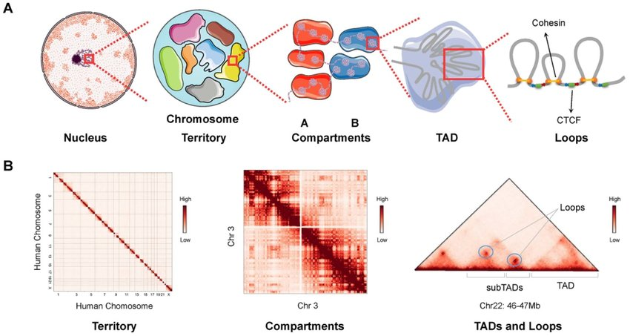
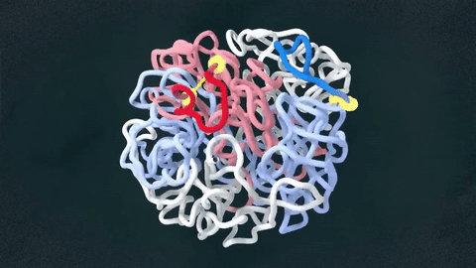
I N T R
O
Hi-C is an experimental technique for investigation of the genome 3D organization.
Hi-C map is a matrix storing the information about pairwise contact frequencies of the genome loci.
This how it may look in 3D
This how it looks in Hi-C
Notes:
Our tiny nucleus have both the volume and the own architecture. And our genetic material is concisely organized in this space. It is highly important to locate the DNA inside the nucleus properly, because it ensures the functioning of all cells and organisms. We are looking at our genome organization through different sequence-based approaches and today we will explain to you how we adapt Hi-C data to both predict genome interactions and enhance the resolution of resulted post-Hi-c maps. Have you ever comprehended how long is your DNA and how your entire genetic material can be stored inside the nucleus in each cell? Try to imagine that 2 meters long DNA is located inside a tiny nucleus. What is the trick? The DNA is packed and condensed with histones to form so called chromatin. We can imagined it as DNA wrapped around core histones to form nucleosomes like the beads on the string. That nucleosome fiber is then organized to form chromosomes. And what is more striking, their folding is also change in time.
The chromatin fiber is represented as a polymer, Hi-C enable to visualise pairwise interactions between loci. Hi-C map is the snapshot of averaged chromatin contacts in a population represented by a matrix of pairwise interaction frequencies.
Hi-C establishes genome features: at the largest scales, chromosomes form territories characterized by decay of contact frequencies with the genomic distance between loci. Within the territories, we can distinguish compartments that correspond to different chromatin types: active or inert. At a finer scale, specific loci may preferentially interact with each other, forming topologically associated domains (TADs) , stripes, loops.

Slide 3
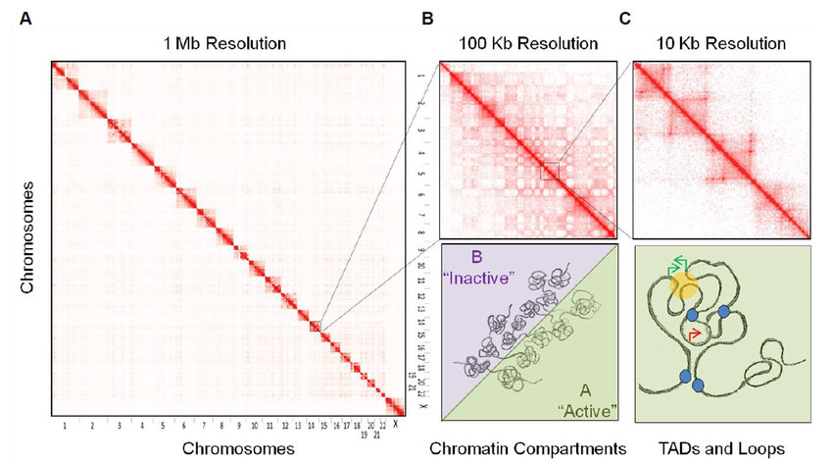
H
Y
P
O
T
H
E
S
I
S
Higher resolution of Hi-C yields more useful information about DNA structure.
It was shown that DNA itself contains information about its conformation.
Can we develop a neural network model that is able to combine low-resolution contact map data and sequence data providing high-resolution output?
Le Dily F., Beato M. Signaling by steroid hormones in the 3D nuclear space //International journal of molecular sciences. – 2018.

Slide 4
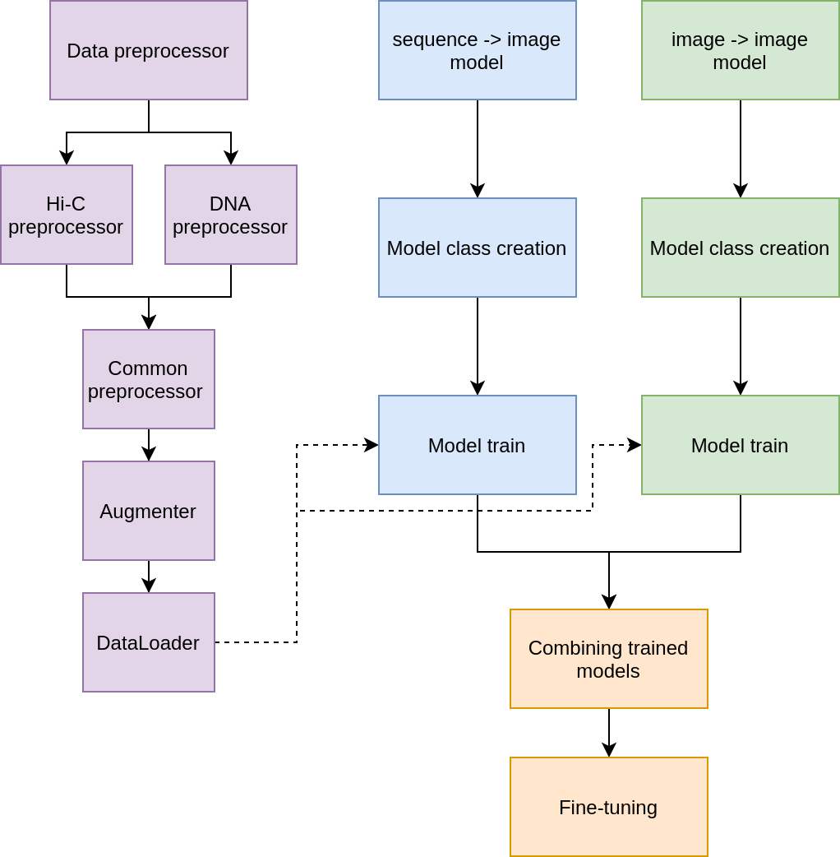
P
I
P
E
L
I
N
E
Steps:
Prepare data: Mouse Embryonic stem cell Micro-C and DNA sequence
Train sequence-> image (DNA -> 3D structure) model
Train image -> image (resolution enhancement) model
Combine outputs of the backbone models
Train Head model
Along with backbones
Separately

Slide 5
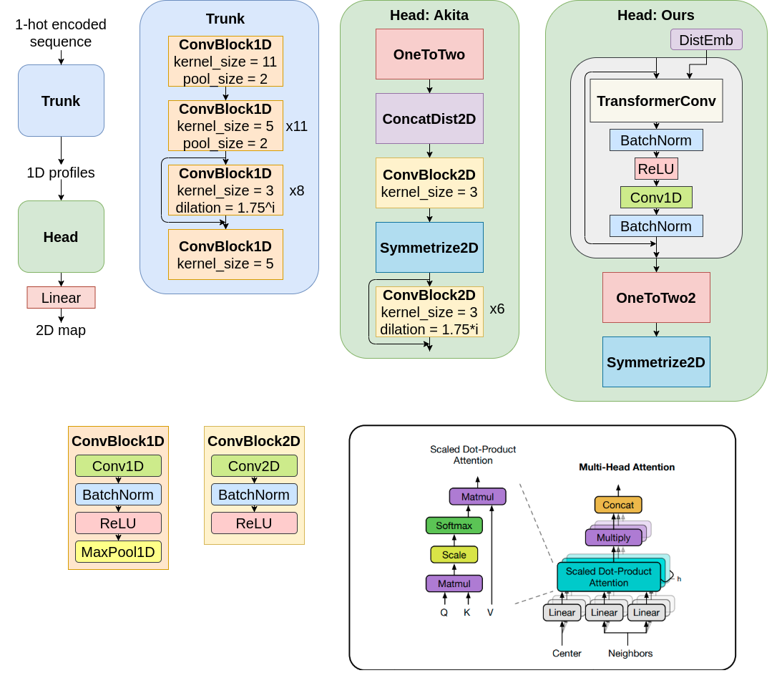
S E Q ↓
I M G
Trunk - deep conv tower encoding very long (1M) DNA sequence to vector
Head - block providing 1D -> 2D transformation.
We tried different head architectures; DNA-BERT sequence embeddings and augmentations to train this model.

Slide 6
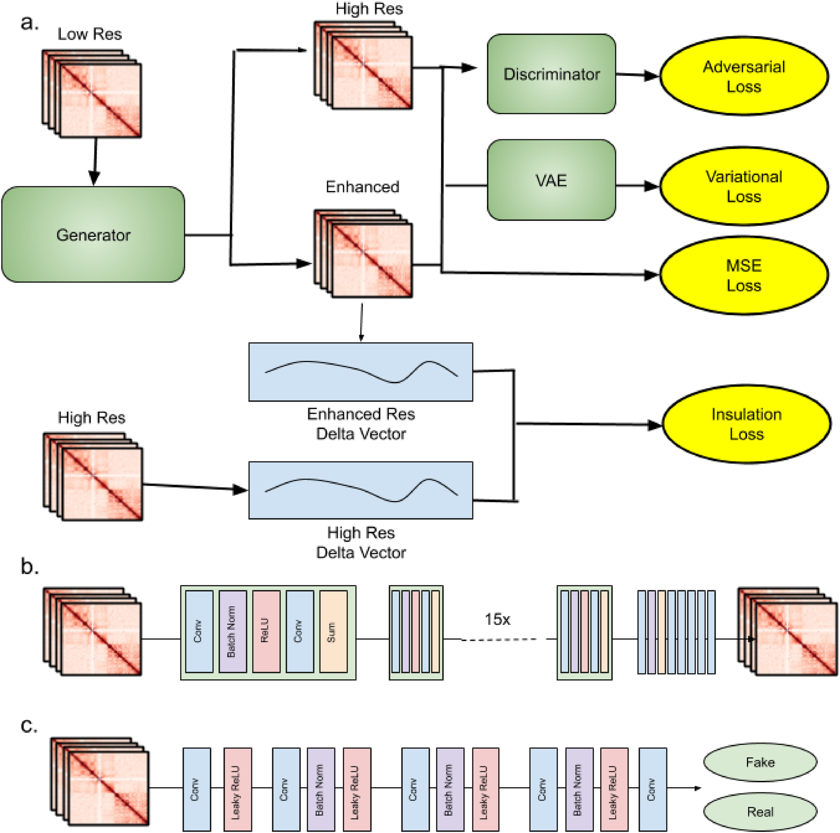
I M G ↓
I M G
Generator of the GAN used as Image->Image model trained on combination of losses
Insulation loss computation
Generator
Discriminator

Slide 7
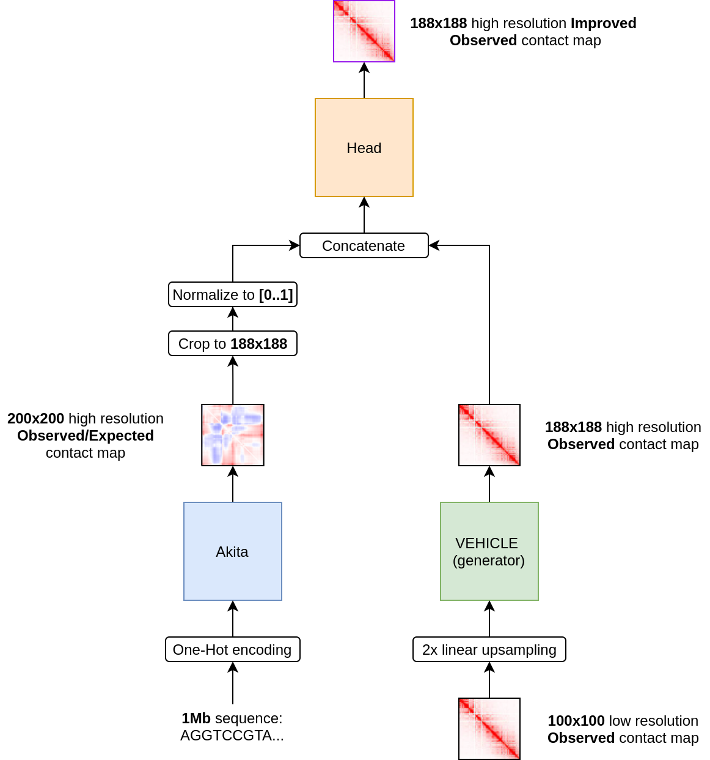
H
Y B R I D
We tried different head architectures, all they are rather simple, for instance:
2 conv layers with ReLU to combine the backbone outputs.
We use MSE loss for training head.
We use Pearson | Spearman (and others) correlations for validation.

Slide 8
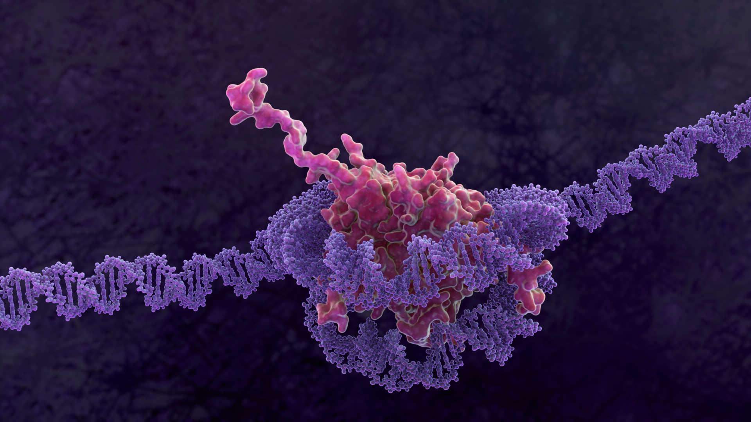
RESULTS

Slide 9
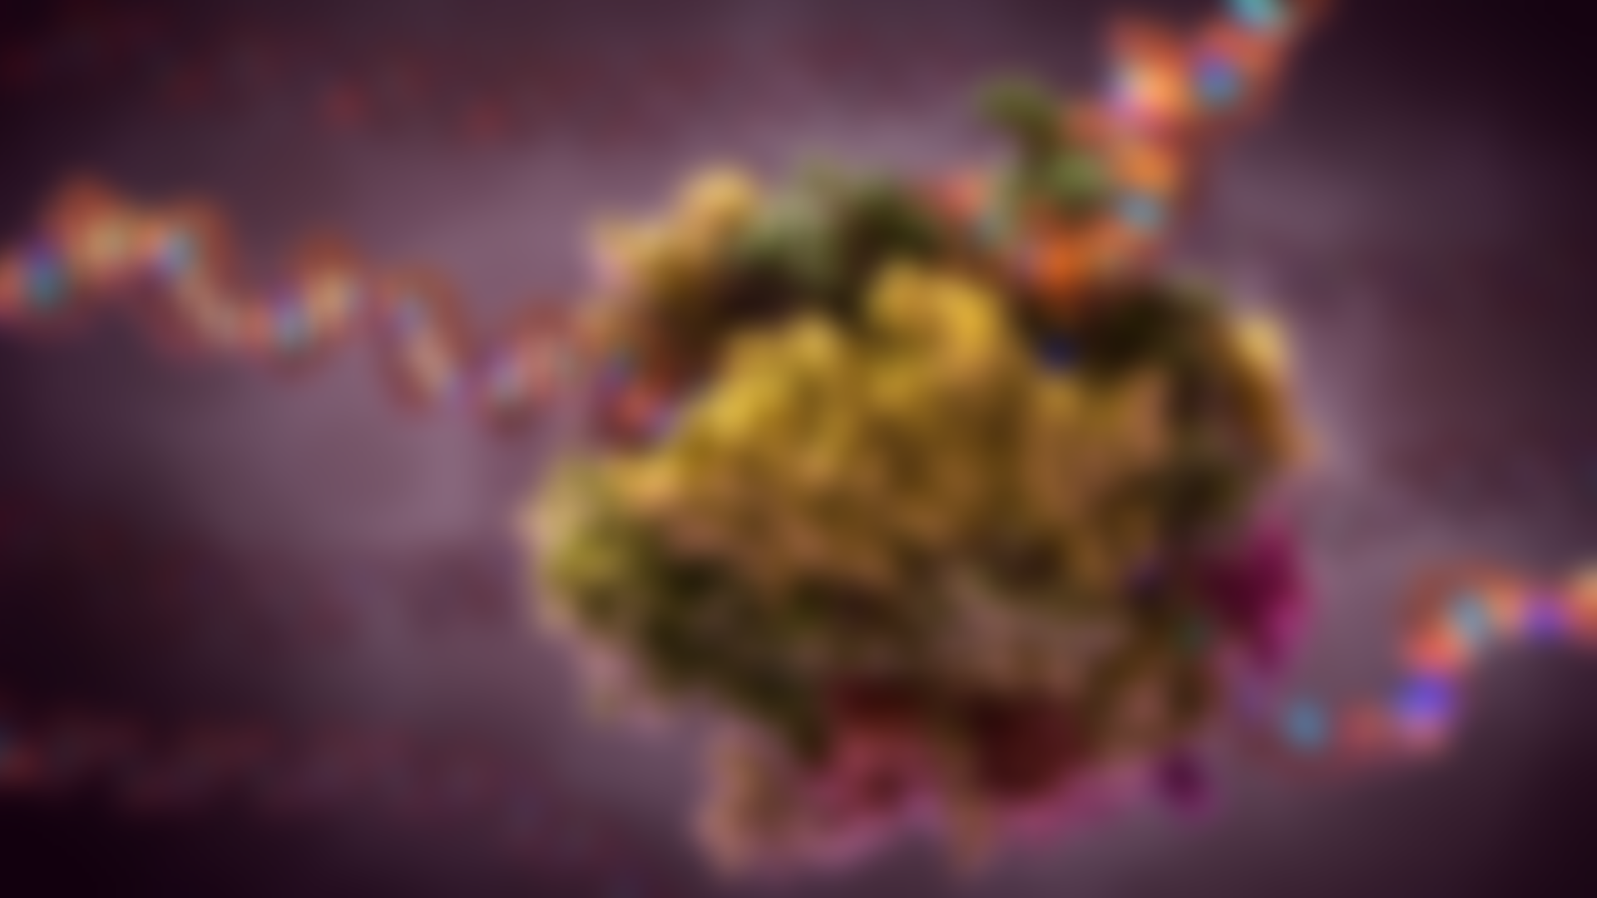
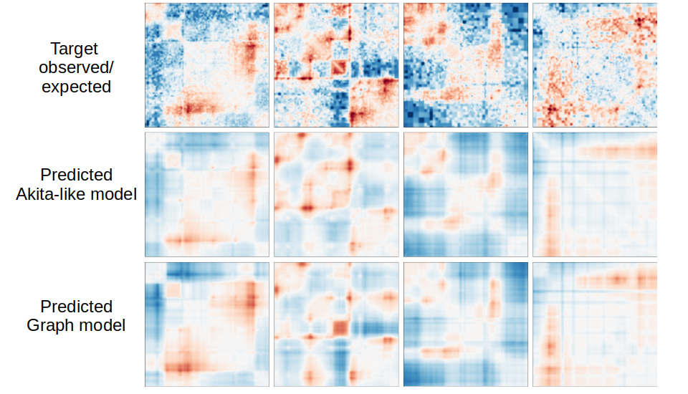
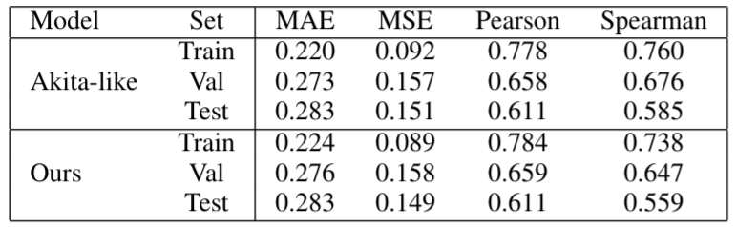
Only seq->img
predictions
Conv and Graph heads learn slightly different patterns
Good results,
we did not worse)

Slide 10
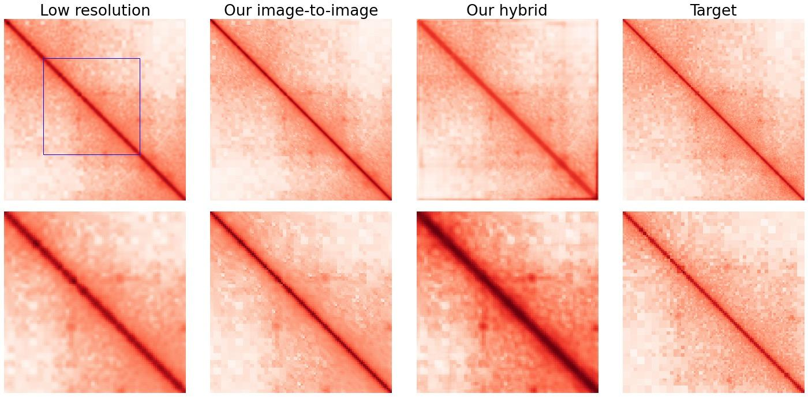
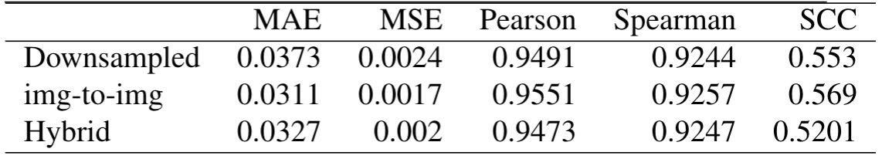
Some region
Detailed
FAIL: our hybrid approach did worse than
SOTA (img-to-img)

Slide 11
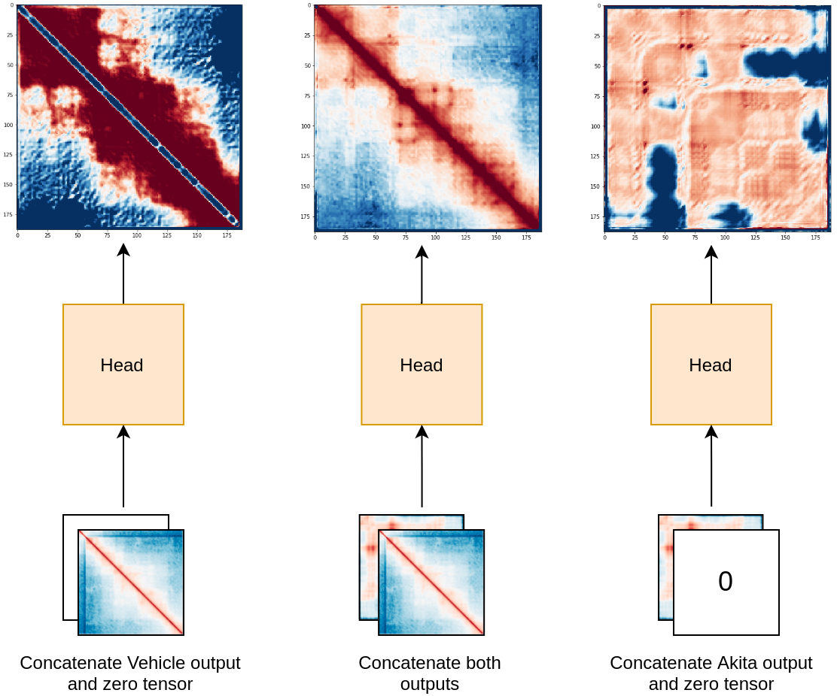
Why combined model fail
We assumed that in case of useless seq->img output the head suppress it.
But in reality the head started to use both backbone outputs in some complex manner.
And therefore spoiled itself.

Slide 12
C
O N C L U S I O N
It’s not easy to combine two models hoping to achieve better resolution enhancement results.
It’s naively to expect that network refuse useless data channels on its own.
Separately trained, our backbone networks yield good results.

Slide 13
Acknowledgements:
http://www.robmaurice.com/portfolio_page/cell-nucleus/ - for background images
Mariia Bazarevich for the help with biological details

